Slide 1
Picis Clinicals on a Tablet

Slide 2
Can Picis Clinicals run on a tablet?
Short answer should be: YES
Currently the application works and scales in tablets in 2 different ways. When using a Windows tablet (like a Microsoft Surface) we run the application natively in the device.
When running in iPad or Android tablets we require Citrix or MS Virtual Desktop Services to run the application through a browser.

Slide 3
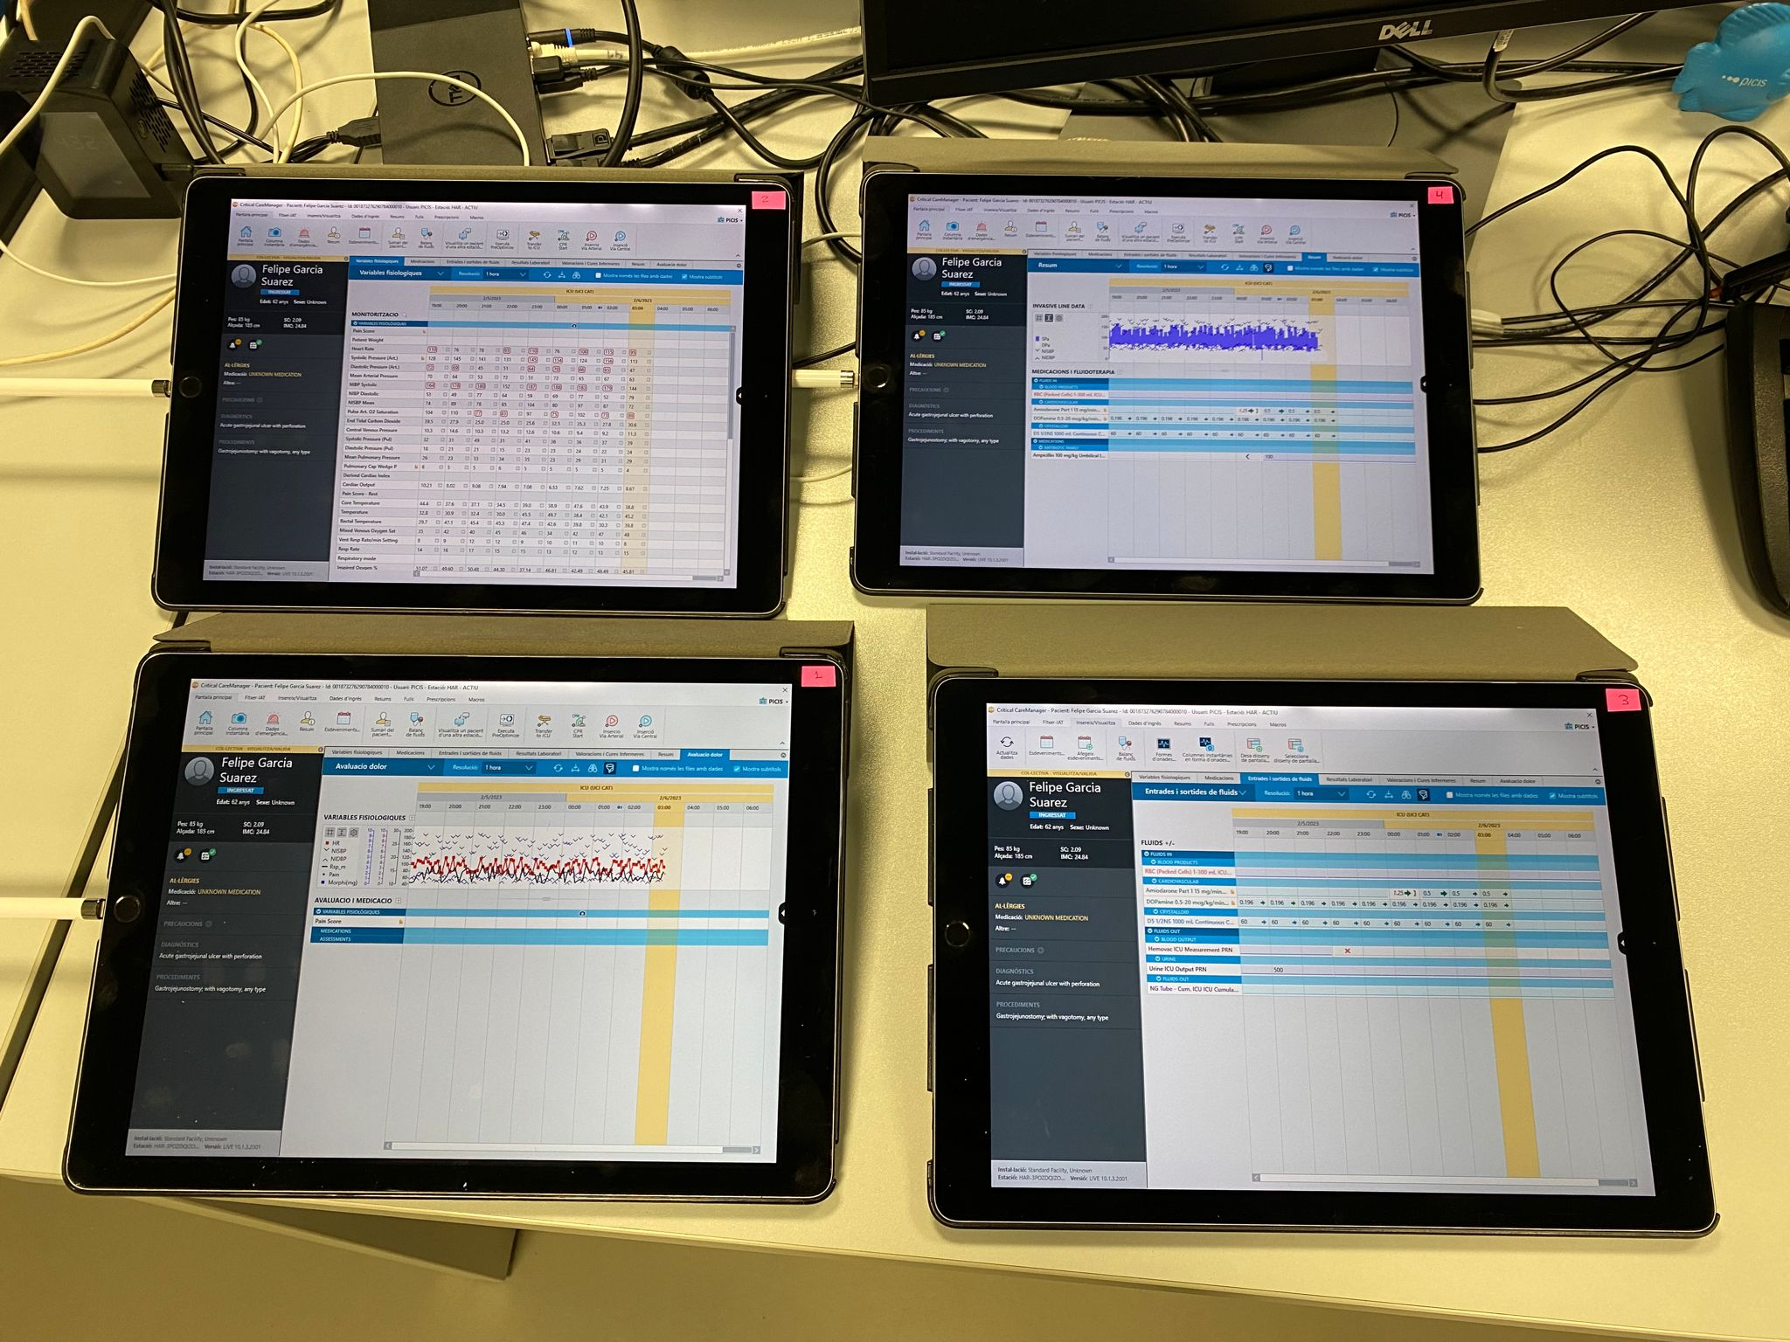
Picis CCM running on tablets

Slide 4
30th Anniversary Logo

Slide 5
Thank you!

